Slide 1
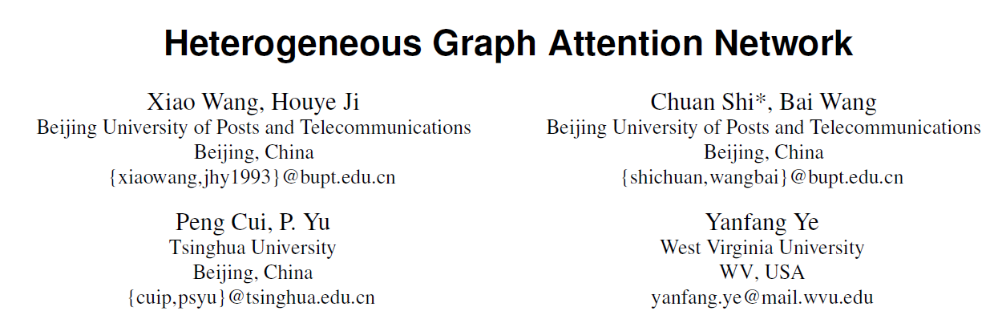

Slide 2
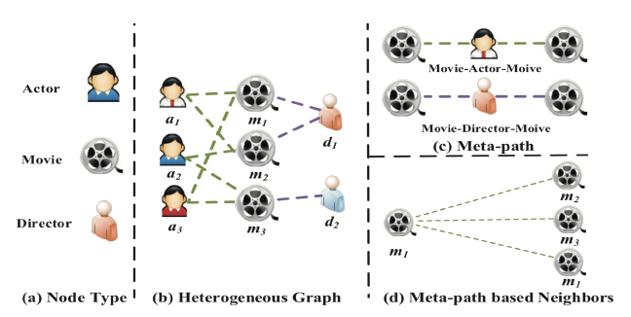
propose a novel heterogeneous graph neural network based on the hierarchical attention, including node-level and semantic-level attentions.

Slide 3
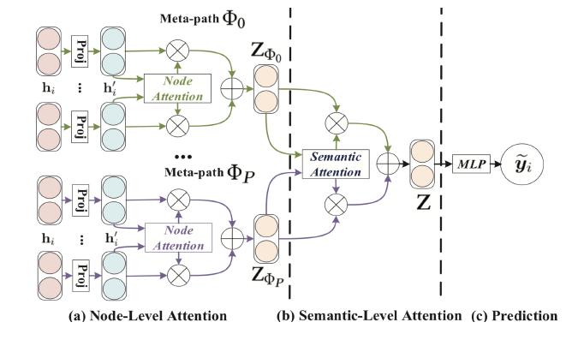
First, we propose a node-level attention to learn the weight of meta-path based neighbors and aggregate them to get the semantic-specific node embedding.
After that, HAN can tell the difference of meta-paths via semantic-level attention and get the optimal weighted combination of the semantic-specific node embedding for the specific task.

Slide 4



Node-level Attention
design the type-specific transformation matrix Mϕi to project the features of different types of nodes into the same feature space.
The importance of meta-path based node pair (i, j)
Asymmetric：the importance of node i to node j and the importance of node j to node i can be quite difference
normalize them to get the weight coefficient
Notes:
where hi and h′i are the original and projected feature of node i, σ denotes the activation function, ∥ denotes the concatenate operation and aΦ is the node-level attention vector for meta-path Φ.

Slide 5

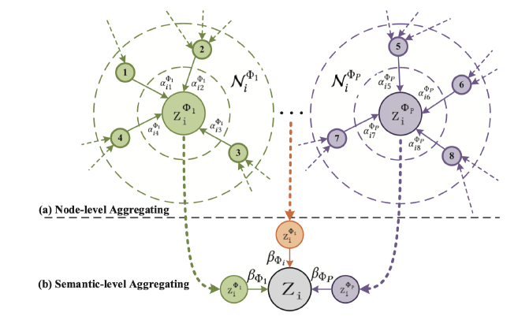
the learned embedding of node i for the meta-path Φ.

Slide 6

heterogeneous graph present the property of scale free, the variance of graph data is quite high.
repeat the node-level attention for K times：
feeding node features into node-level attention

Slide 7

Semantic-level Attention
Taking P groups of semantic-specific node embeddings learned from node-level attention as input, the learned weights of each meta-path：
The importance of each meta-path：
where W is the weight matrix, b is the bias vector, q is the semantic-level attention vector.

Slide 8


Normalize: The weight of meta-path Φi:
Then we can apply the final embedding to specific tasks and design different loss fuction.

Slide 9
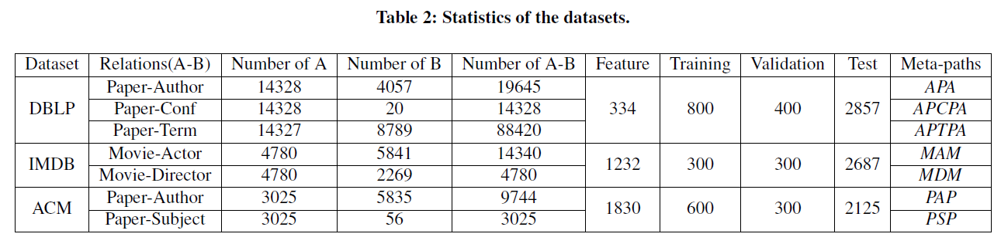
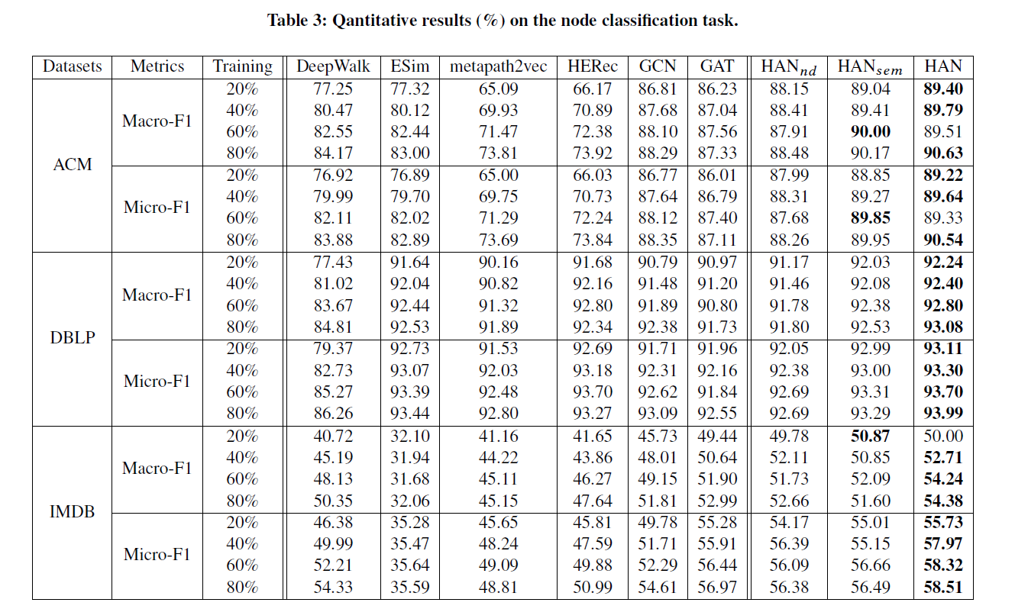

Slide 10
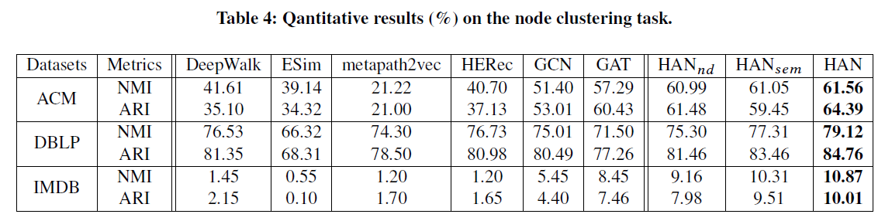
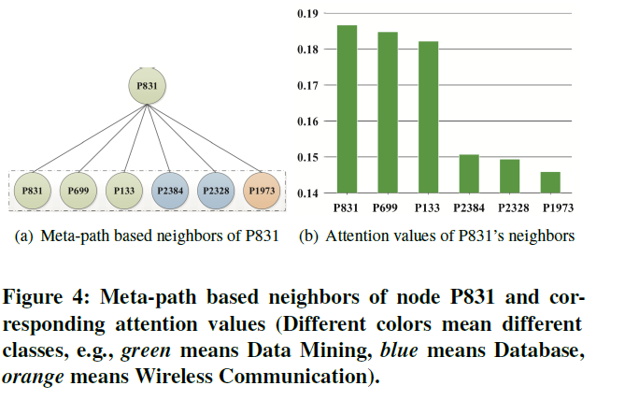
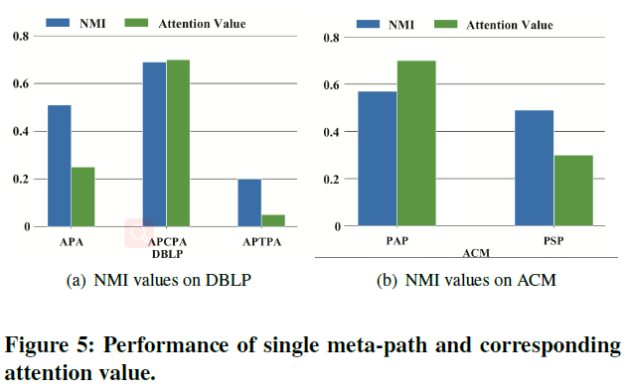

Slide 11
